Slide 1
Job Performance Evaluation Using Back-propagation Network
Petr Stehlík
Faculty of Information Technology, Brno University of Technology
Božetěchova 2, 612 66 Brno xstehl14@stud.fit.vutbr.cz

Slide 2
EXAMON
“Scalable framework for performance and energy monitoring of HPC facilities”
performance counters (pmu_pub)
“package” metrics
IPMI
MQTT transport
“big data” database cluster storage
PBS job hooks

Slide 3
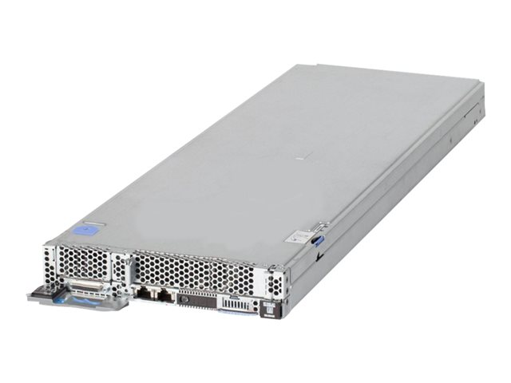
EXAMON ARCHITECTURE
Applications
ADMIN
Grafana
Apache
Spark
Matlab
Examon Web
Front-ends
NoSQL
Cassandra
node₁
KairosDB
Cassandra
node_{M}
Database
MQTT2Kairos
MQTT2kairos
MQTT Brokers
Broker₁
Broker_{M}
Transport
MQTT
CLUSTER
ipmi_pub
pmu_pub
pmu_pub
pmu_pub
pmu_pub
pmu_pub
pmu_pub
Sensors
Management Node
Node₁
Node₂
Node_{n}
Node_{i}
Node_{i+1}
Node_{N}

Slide 4
MQTT
Message Queue Telemetry Transport
Lightweight message queueing and transport protocol
Well suited for low resource demanding scenarios like IoT applications
Basic features:
Publisher-Subscriber model
Async communication protocol (messages)
Low overhead packet (2 bytes header)
QoS (3 levels)

Slide 5
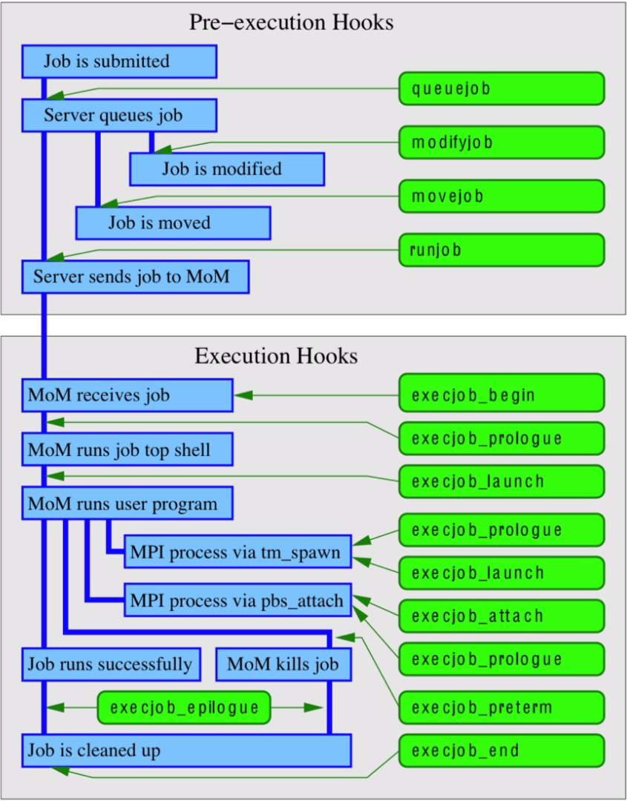
PBS Hooks
Available hooks
runjob
execjob_begin
execjob_end
Sent via MQTT
Stored to Cassandra
Info about the job, user & used resources

Slide 6
EXAMON WEB
“Visualization of performance, power and energy statistics of HPC applications and cluster status.”
Utilize data gathered from Examon & PBS
Provide insights on user’s jobs
System administrator overview
of a cluster
Combine metric and job data
3D model

Slide 7
EXAMON WEB ARCHITECTURE

Slide 8
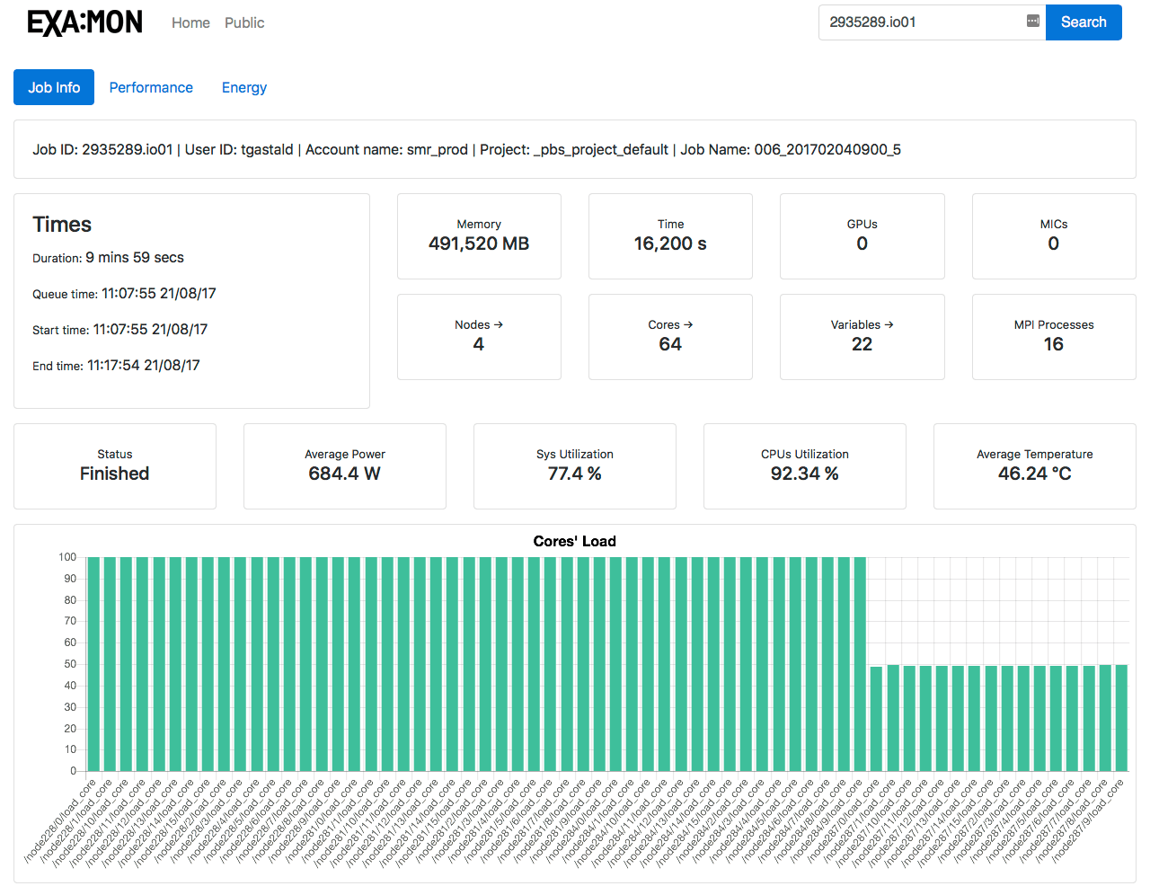
EXAMON WEB: JOB OVERVIEW

Slide 9
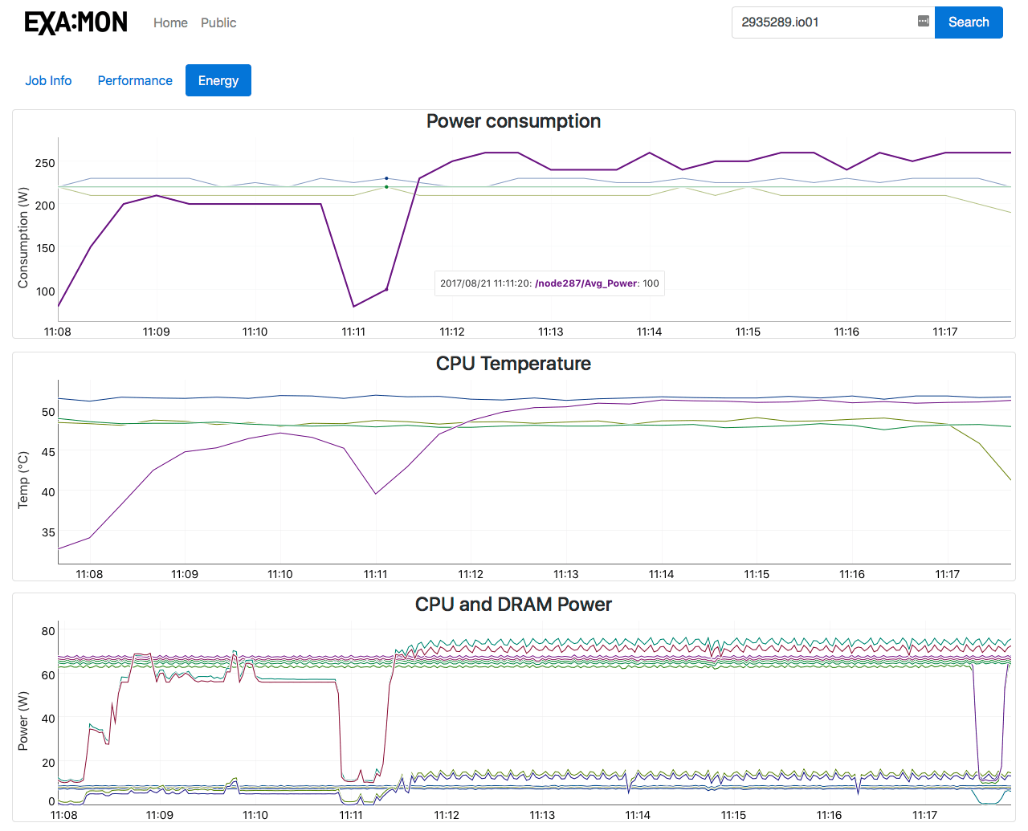
EXAMON WEB: JOB ENERGY DASHBOARD

Slide 10
EXAMON MONITORED METRICS
PMU
Temp
IPS
clk_curr
clk_ref
C3
C6
cpi
C3res
ips
freq_ref
freq
dT_core
C6res
load_core
IPMI
pow_dram
pow_pkg
temp_pkg
erg_pkg
erg_dram
erg_units
freq_ref
C2
C3
C6
Uclk
Avg_Power
Sys_Utilization
CPU_Utilization
Mem_Utilization
IO_Utilization
PCH_Temp
Ambient_Temp
HDD_Inlet_Temp
PCI_Riser_1_Temp
PCI_Riser_2_Temp
GPU_Outlet_Temp
CPU1_Temp
CPU2_Temp
TMAM
back_end_bound
core_bound
L1L2_bound
front_end_bound
retiring
bad_speculation
L3_bound
issue_loss_idle

Slide 11
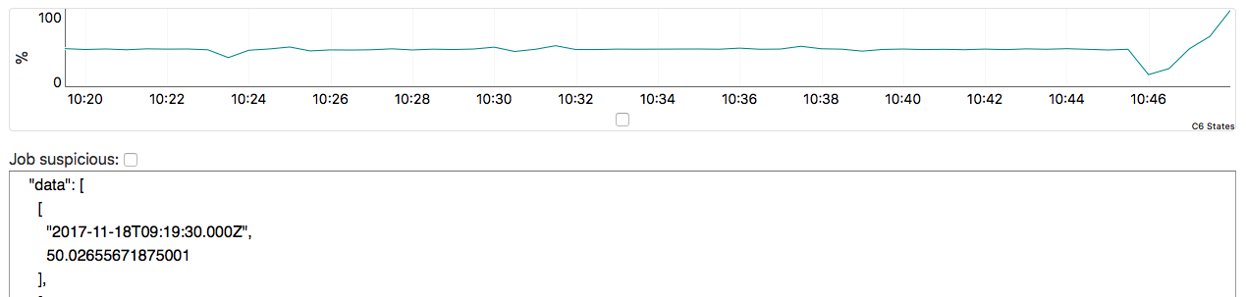
DATA LABELLING
Every job
10 – 60 minutes long
Full node occupation (modulo 16 cores)
Run in between certain dates
Every metric
aggregated to 30 s
Interpolated to 80 values
Manual metric/job labelling with custom tool

Slide 12
Classification Network
Back-propagation with stochastic updates
Network for each metric (80-4-3-1)
80 input neurons
4 and 3 neurons in hidden layers respectively
1 output neuron
Job classification network (12-4-1)
12 input neurons (one for each metric)
4 neurons in hidden layer
1 output neuron

Slide 13
RESULTS
Metric | Epochs (ε < 0.1) | Sum Error
core’s load | 49 999 | 5.81947
C6 states | 1506 | 0.07591
C3 states | 4 | 0.09447
IPS | 49 999 | 3.18977
system utilization | 17 988 | 0.09695
CPU utilization | 49 999 | 7.65817
IO utilization | 49 999 | 0.94946
memory utilization | 49 999 | 0.82774
L1 and L2 bounds | 49 999 | 0.52690
L3 bounds | 49 999 | 0.77589
front-end bounds | 49 999 | 2.72293
back-end bounds | 49 999 | 4.63103
job classifier | 49 999 | 0.73037
Job # | Expected | Result
1 | 0 | 0.04
2 | 0 | 0.05
3 | 0 | 0.58
4 | 1 | 1.0
5 | 1 | 0.98

Slide 14
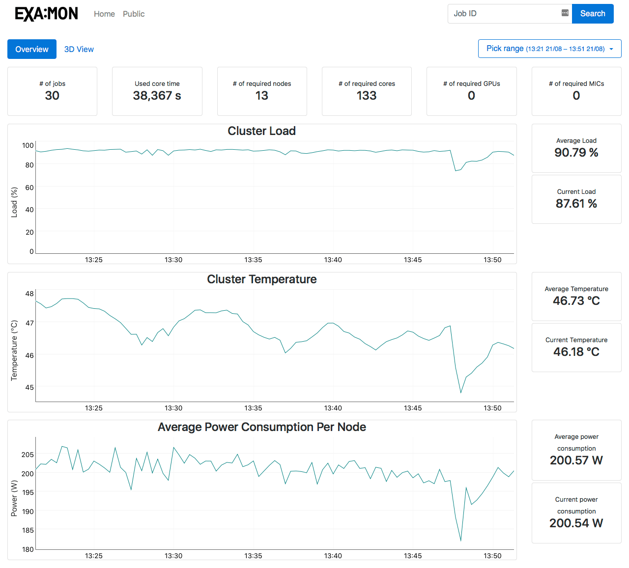
EXAMON WEB: SYSTEM ADMIN OVERVIEW

Slide 15
EXAMON WEB: 3D MODEL

Slide 16
FURTHER WORK
Anomaly detection in running jobs
Job performance analysis and classification
Adjustable dashboards
“Smart dashboard”
”Job management”
Users
Cluster visualisation

Slide 17
SUMMARY
web interface for Examon framework
connection between two different data sources
integration of 3D model
large user base to affect
Advanced analysis and classification of jobs
Job overview
Available on GitHub: https://github.com/petrstehlik/examon-web

Slide 18

Thank you for your attention &
visit me during the poster session
Petr Stehlík | @petrstehlik
http://www.fit.vutbr.cz/research/groups/sc@fit/

